Slide 1
Company Introduction
Shenzhen Jiaodi Ren Technology Co., Ltd
Reporter: 阿杰

Slide 2
Catalog
01
Basic Information
02
Key Advantages
03
Company Highlights
04
Contact Information

Slide 3
Basic Information
PART 01

Slide 4

Legal Address
Dongguan, Guangdong Province
550㎡ Production Facility
Located in Dalingshan Town, Lianshan County, Dongguan City, Guangdong Province.
The company operates a production facility spanning 550 square meters.

Slide 5
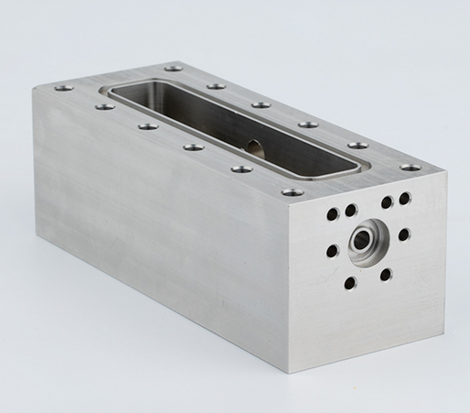
Business Scope
Titanium Alloy and Stainless Steel Processing
Precision Parts Manufacturing
Specializes in the processing of titanium alloy and stainless steel materials.
Engages in the manufacturing of high-precision parts for various industries.

Slide 6
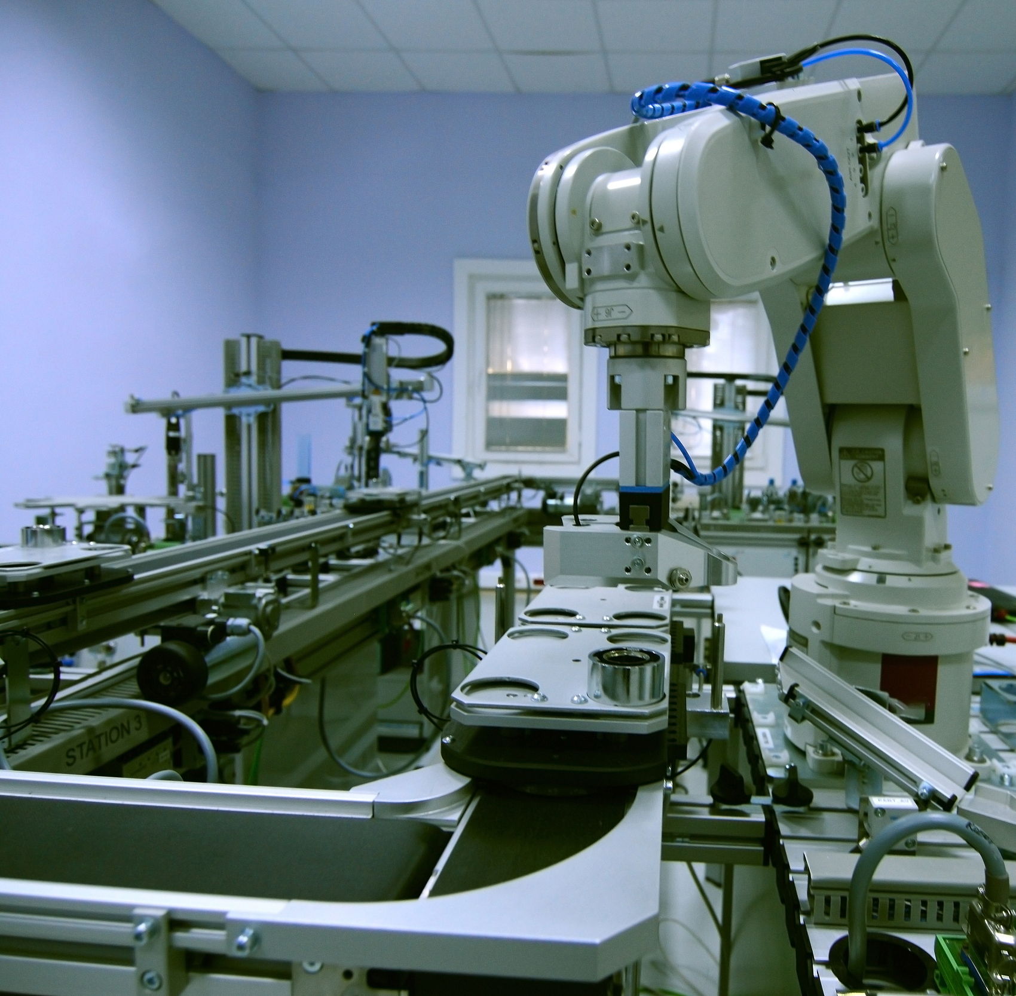
Business Scope
Design and Production of Titanium and Stainless Steel Products
Offers design and production services for custom titanium and stainless steel products.

Slide 7
Business Scope
Customer Service
  Provides comprehensive customer service to meet diverse industrial needs.

Slide 8
Key Advantages
PART 02

Slide 9
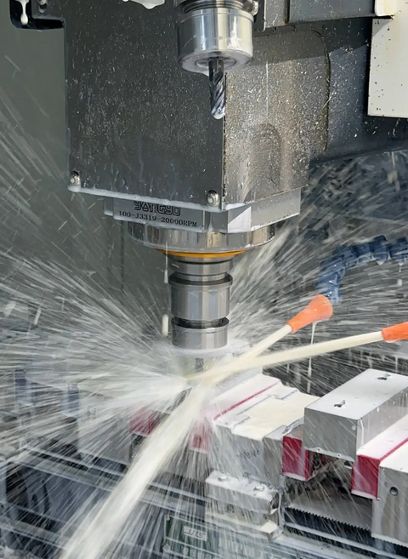
Industry Resources
Partnered with a leading titanium supplier in Baotou, ensuring stable raw material supply.
Partnership with Titanium Supplier
Over a decade of experience in titanium alloy and stainless steel processing.
Titanium Industry Expertise

Slide 10
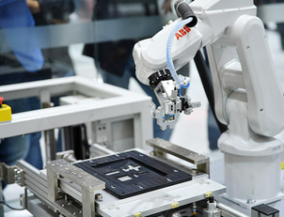
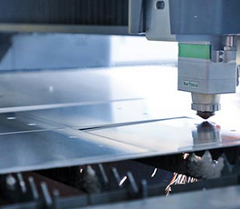
Manufacturing Equipment
Advanced CNC Technology
Precision Manufacturing
Utilize CNC machining centers, lathes, milling machines, and wire cutting machines.
Equipped with state-of-the-art equipment for high-precision metalworking.

Slide 11
Quality Control
01
High-Precision Instruments
Employ height gauges and projection instruments for quality assurance.
02
International Standards Compliance
Deliver products that meet international quality standards through rigorous control.

Slide 12
Company Highlights
PART 03

Slide 13
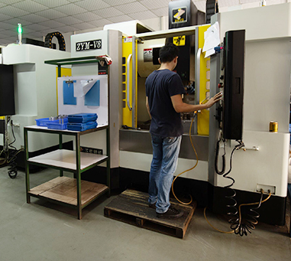
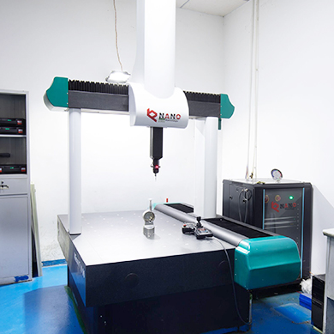
Years of Experience
Decade of Expertise
Complex Precision Parts
Over 10 years of experience in processing titanium alloys and stainless steel.
Accumulated expertise in manufacturing complex precision parts.

Slide 14

Customer-Oriented Solutions
Exceeding Client Requirements
Committed to surpassing client needs through continuous innovation.
Continuous Innovation
Dedicated to developing customer-oriented solutions with innovation.

Slide 15
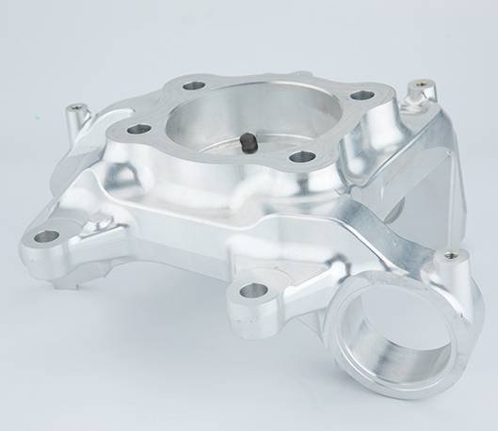
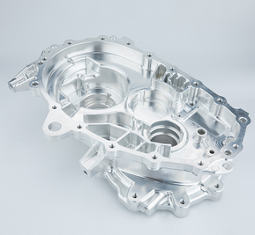
State-of-the-Art Facilities
Equipped with CNC Technology
Product Reliability Assurance
State-of-the-art facilities featuring CNC machining centers and precision testing tools.
Advanced equipment ensures product reliability and precision.

Slide 16
Contact Information
PART 04

Slide 17
Thanks
Shenzhen Jiaodi Ren Technology Co., Ltd
Reporter: JACK YANG

